Slide 1
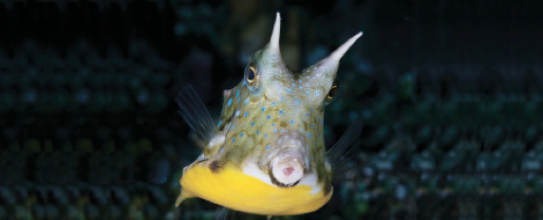
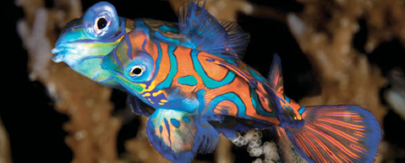
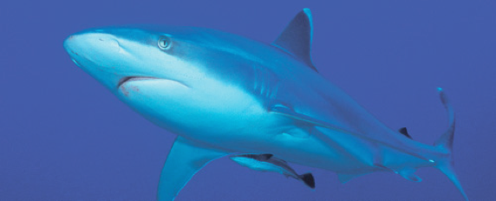
Lesson 8 Taxonomy II
Ichthyology
Shanghai Ocean University
Fall, 2022

Slide 2
Teleosts II – Salmonids to Frogfishes
Protocanthopterygii
Paracanthopterygii

Slide 3
Euteleostei
The fourth subdivision, contains three-quarters of the families and two-thirds of the species of teleosts.
Family Higher Grouping
Salmonidae (salmon and trout)
Osmeridae (smelts)
Esocidae (pikes)
Umbridae (mudminnows)
Protocanthopterygii

Slide 4
Protacanthopterygians
Protacanthopterygians are loosely related marine, freshwater, and diadromous fishes that include the deepsea argentiniforms, salmons, and smelts. Whitefishes, graylings, salmons, and trouts constitute the salmoniforms, characterized by an adipose fin, a triangular flap at the base of the pelvic fin, and the configuration of the last three vertebrae.
Many salmonids undergo extensive migrations between fresh and salt water during their lives.
Osmeriforms are generally small, silvery, elongate, water column dwelling fishes such as freshwater smelts, deepsea barreleyes and slickheads, and southern hemisphere Salamanderfish and galaxiids.

Slide 5
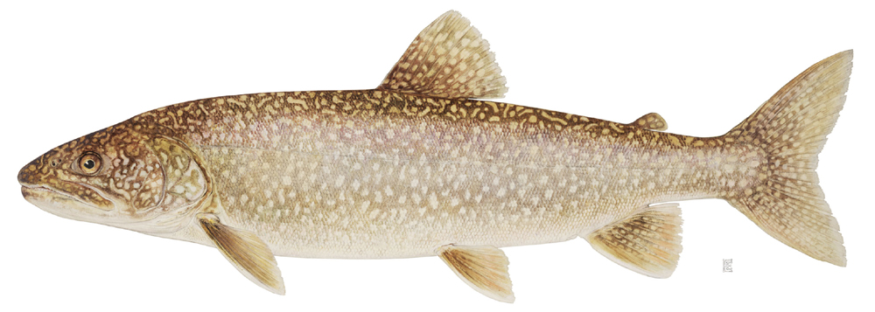
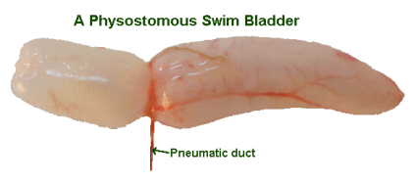
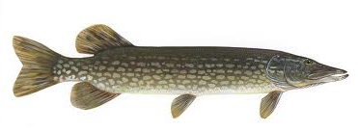
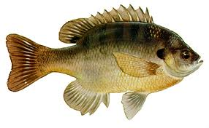
Protocanthopterygii
Considered the most basal or ‘primitive’ teleosts.
-Lack spines in fins
-Many possess adipose fin (see trout)
-Pelvic fins relatively far back on body
-Physostomous swim bladder
-direct connection between gut and swim bladder
-allows fish to fill swim bladder by gulping air

Slide 6
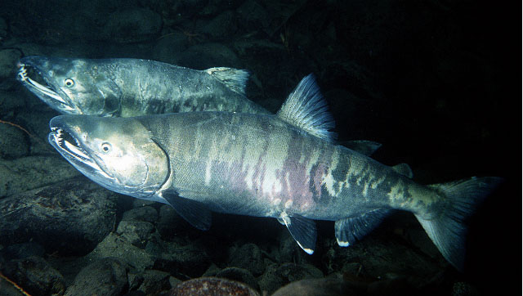
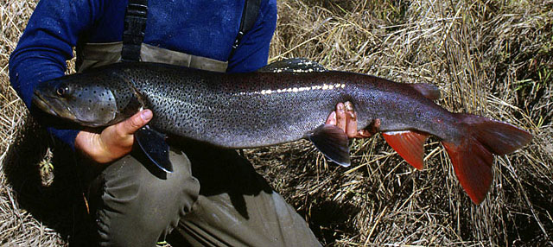
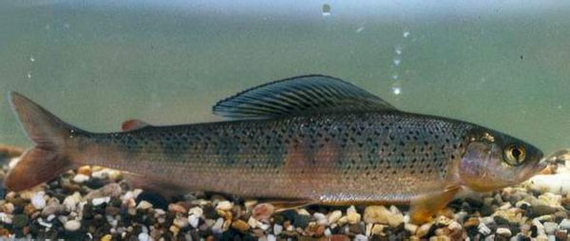
Salmoniformes
Oncorhychus keta 大马哈鱼；
Hucho tcimen 哲罗鱼；
Thymallus arcticus 茴鱼；

Slide 7
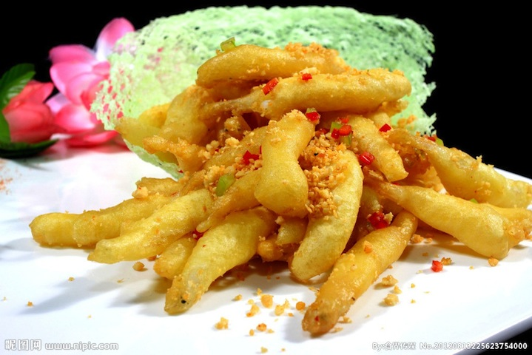
Osmeriformes
Plecoglossus altivelis 香鱼 (ayu or sweetfish)；
Protosalanx hyalocranius 大银鱼 (icefish)；

Slide 8
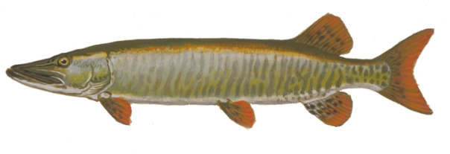
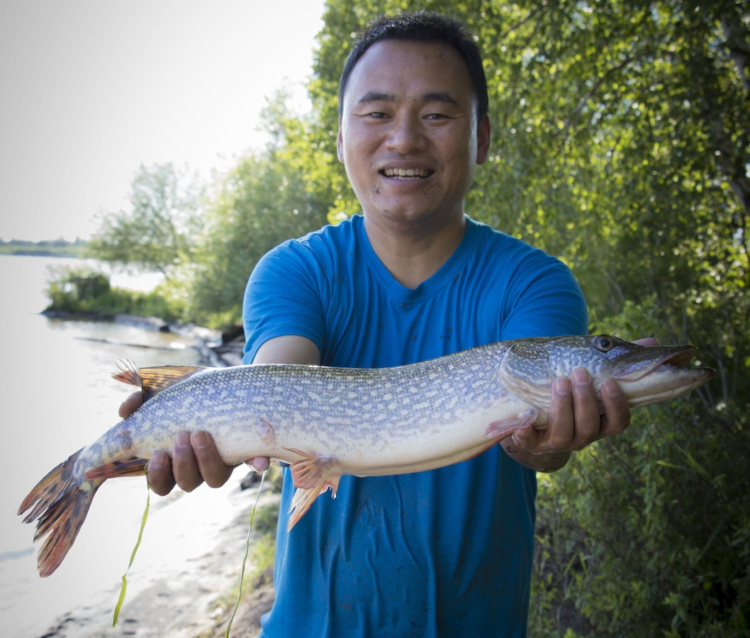
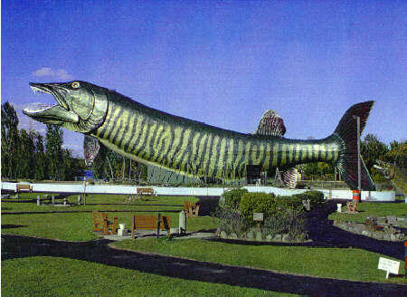
Family Esocidae – the pikes
Elongate lie-in-wait predators
Only five species:
northern pike (Esox lucius)
muskellunge (Esox masquinongy)
Grass/redfin pickerels (Esox americanus)
chain pickerel (Esox niger)
Amur pike (Esox reichertii)
Huge economic importance
as sportfish!

Slide 9
Euteleosts - Neoteleostei
the remaining 335 families and 17,000+ species – are collectively placed in the unranked taxonomic category Neoteleostei.

Slide 10
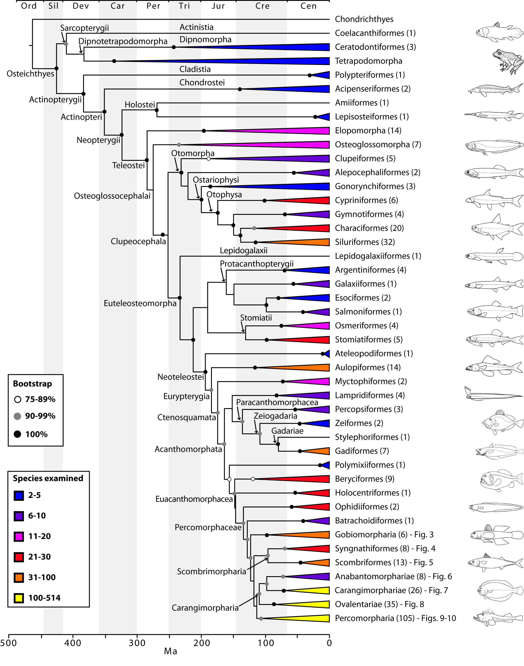
Teleost Phylogeny

Slide 11
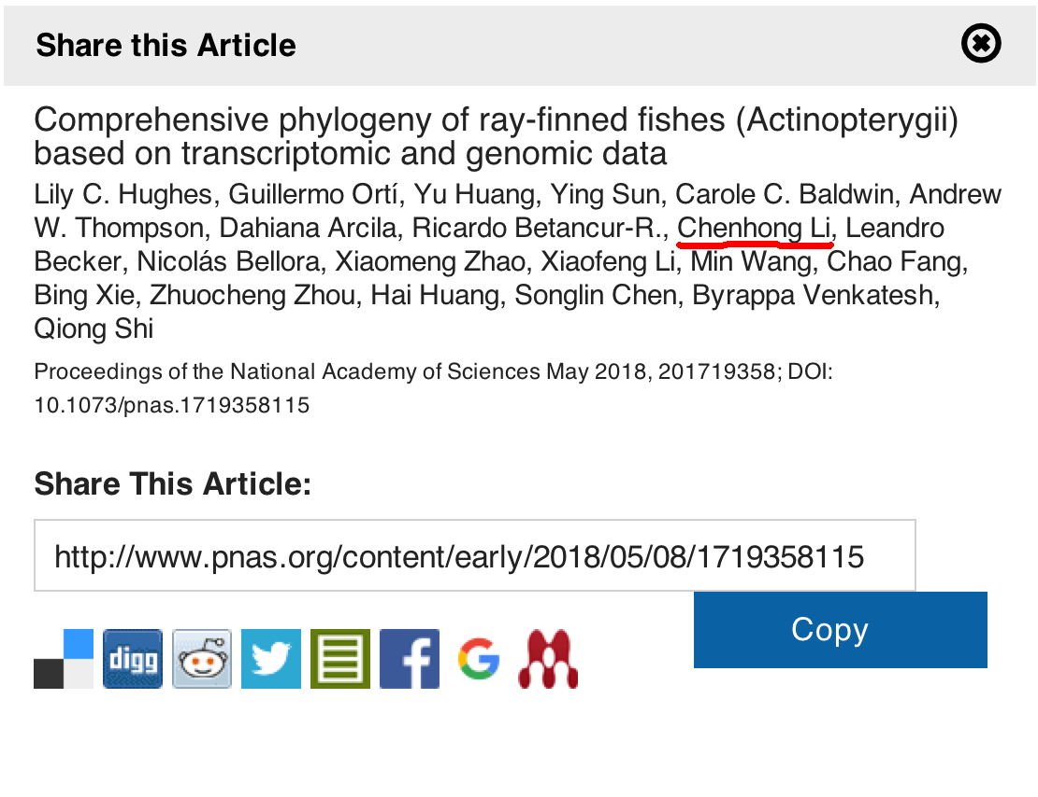

Slide 14
Paracanthopterygii
Spines on dorsal, anal, and pelvic fins
Pelvic fins anterior on the body (below pectorals)
Protractile premaxilla
-enables different feeding modes
Percopsidae (troutperches)
Aphredoderidae (pirate perch)
Gadidae (cods)
Antennariidae (frogfishes)

Slide 15
Paracanthopterygii
The superorder consists of freshwater cavefishes and trout-perches, but mostly of marine, benthic, nocturnal fishes, including very deepsea ophidiiforms, commercially important cods, acoustically active toadfishes, anatomically specialized batfishes and handfishes.

Slide 16
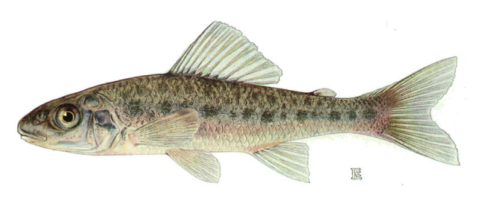
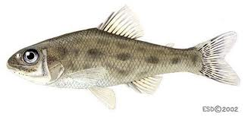
Family Percopsidae - troutperches
Only two species; one native to Wisconsin
Why “troutperch”?
Looks like a cross between a trout and a perch.
Percopsis omiscomaycus
Other is the sand roller,
Percopsis transmontana
Native to Columbia River drainage in Pacific Northwest
Percopsis transmontana

Slide 17
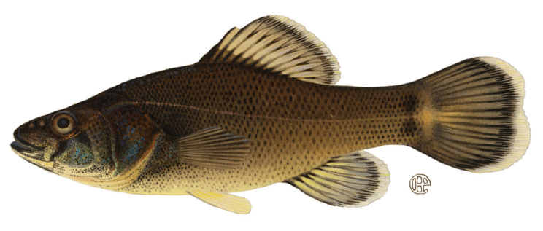
Family Aphredoderidae – the pirate perch
Only one species in the family:
Aphredoderus sayanus, the pirate perch
Native to Wisconsin
Peculiar developmental pattern
-anus migrates from typical
position to the anterior
portion of the body near the
throat
-WEIRD, huh??? WHY?

Slide 18
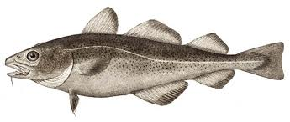
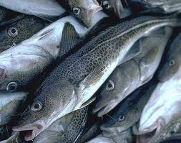
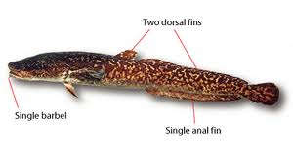
Family Gadidae – the cods
55 species
Dorsal fin divided into two or
three sections
Also distinguished by single barbel on chin
Huge economic importance
Gadus morhua 鳕
(but overfished!)
All marine except for one species,
the burbot, Lota lota (江鳕)

Slide 19
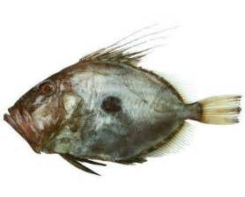
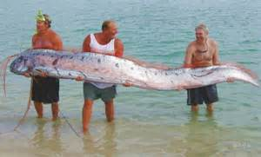
Zeiformes & Lampridiformes
Zeiformes Zeus japonicus 日本海鲂；
Lampridiformes Regalecus russelli 勒氏皇带鱼

Slide 20
Presentation for next week (Nov 20)
???
List the common features of the superorder Acanthopterygii and give exemplary species
???
Describe the family Cichlidae, including taxonomy, distribution, ecology, importance, etc.
???
Describe the superfamily Gobioidei (now Gobiiformes), including taxonomy, distribution, ecology, importance, etc.
???
Trends during teleostean phylogeny

Slide 21
HWK
Homework 8.docx
due on Nov 20
No late hand-in will be graded
Read Chapter 14&15

Slide 22
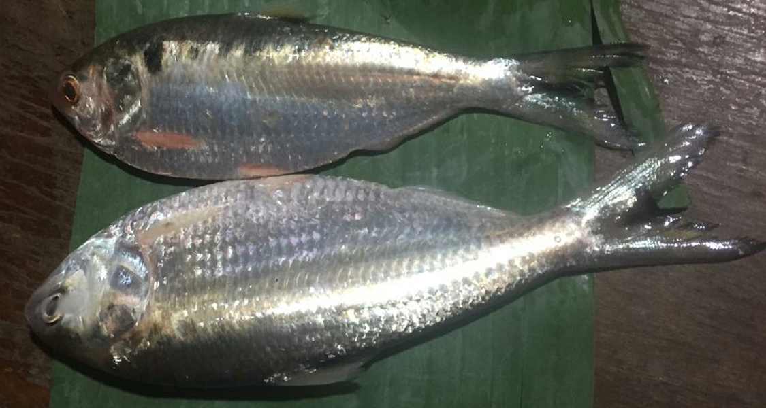
Have a nice week!
The Mekong herring, Tenualosa thibaudeaui, Nov, 2019

